Slide 1
Into Space
Name: Sardar Moktadir Ibna Mohsin
ID: 011 153 112
Name: Farhin Rahman Fiona
ID: 011 153 059

Slide 2
Introduction
It’s a 2D arcade game.

Slide 3
description of your individual task
Fiona: Designing (Front)
Sardar: Logic building (Back end)

Slide 4
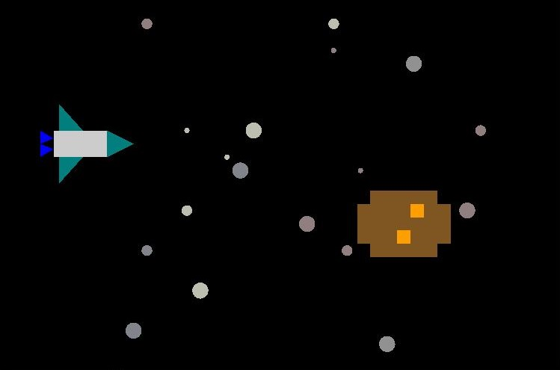
Screenshot

Slide 5
Thank You

